Slide 1
ARE WE THERE YET?
PERSPECTIVES OF THE TRIBULATION
GASPER SIFUENTES AUGUST 28TH, 2024

Slide 3
ARE WE THERE YET?
PERSPECTIVES OF THE TRIBULATION
GASPER SIFUENTES AUGUST 28TH, 2024

Slide 4
LEARNING OBJECTIVES
In This Lesson you will learn
The Current State of Israel
The 4th Beast
Rapture & Ruling In The Millennium

Slide 5
WARNING
THIS LESSON IS DESIGNED TO MAKE YOU THINK
This lesson is meant to make you consider possibilities based upon scripture. You are to do your own study and prayerfully come to your own conclusions. I ask that you remember that the Pharisees believed messiah would come as a great military leader and their tradition and interpretation of Torah that blinded them. We cannot put God in a box, as they did. They missed Jesus.

Slide 6
Current War In Gaza
Surrounded
ATTACK - Oct 7th, 2023
Iran Funded this war by Biden Administration Policies. est. $6 Billion (RELEASED SANCTIONS)
Proxy War - Hamas, Houthi and Hezbollah
Luk 21:20 ¶“But when you see Jerusalem surrounded by armies, then know that its desolation is near.
Luk 21:21 “Then let those who are in Judea flee to the mountains, let those who are in the midst of her depart, and let not those who are in the country enter her.
Luk 21:22 “For these are the days of vengeance, that all things which are written may be fulfilled.

Slide 7
U.S. Middle East Troop Operations
Jordan
Syria
Egypt (Raffa Crossing)

Slide 8
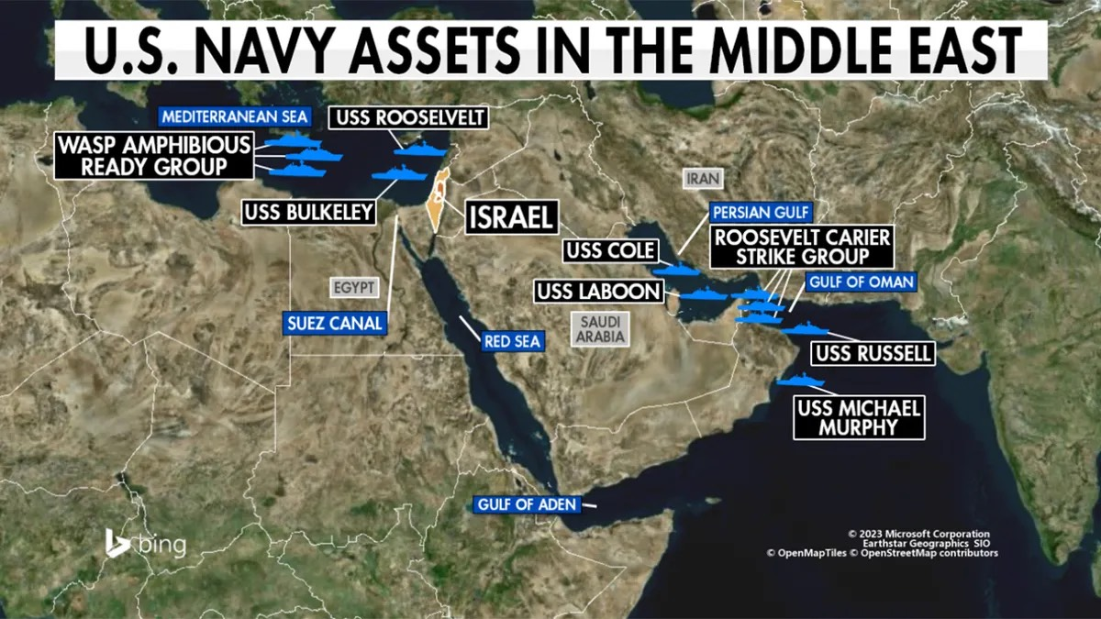
US Navy
Mediterranean Sea
Red Sea
Persian Gulf

Slide 9
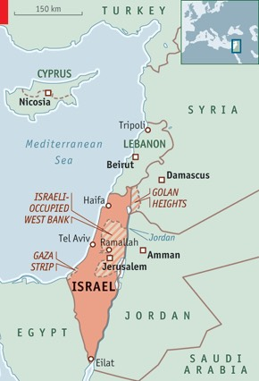
Enemy Camps
Hamas - Gaza
Hezbollah - Lebanon
Houthi- Yemen
PLO - Westbank & Golan
Indeed we see the possible fulfillment of this Luke 21 prophesy .

Slide 10
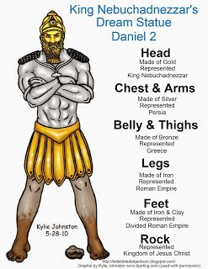
The 4th Beast
Rome
Convention wisdom appoints the legs of Iron to represent the Roman Empire.
Feet. A renewed Roman Empire?
The Feet of Clay and Iron mean that the “renewed” Roman empire does not Mix well, Mixed seed, this alliance is very fragile. Perhaps a loosely joined political state that includes the Muslim community and the lands and people it governs. Caliphate.

Slide 11
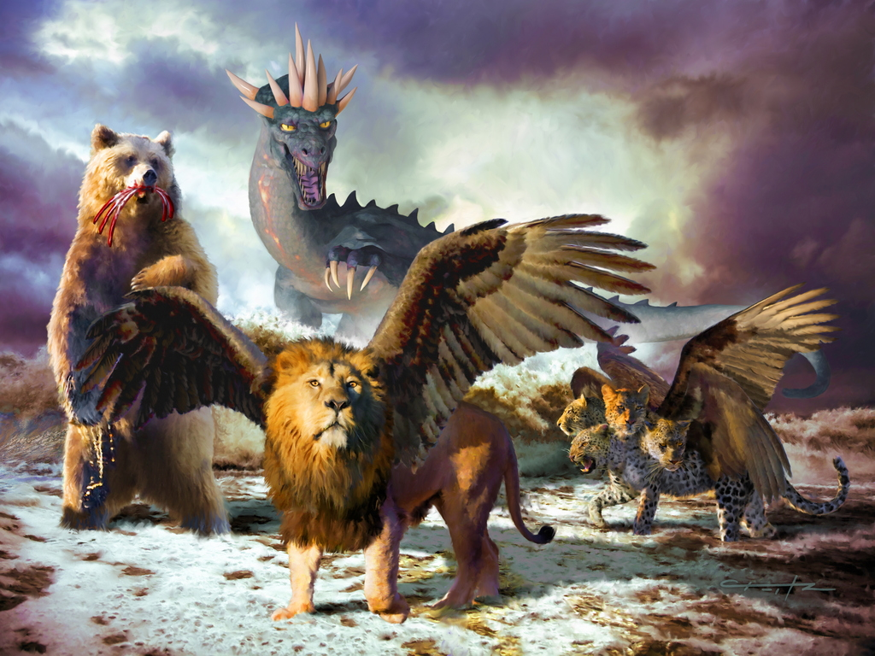
Babylon
Babylon is the Lion
Medio-Persians- The Bear
Greeks- The Leopard
The Romans, conquered the Greeks which included Babylon. The 4th Beast.
All described in Daniel 7 in detail.

Slide 12
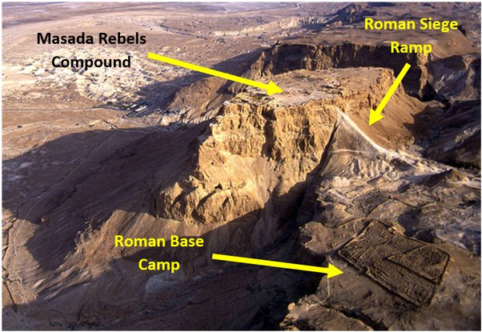
Rome
What People?
Rome has always been suspected of fulfilling this end times prophesy.
Dan 9:26 “And after the sixty-two weeks Messiah shall be cut off, but not for Himself; And the people of the prince who is to come Shall destroy the city and the sanctuary. The end of it shall be with a flood, And till the end of the war desolations are determined.
Means an actual Flood by water or could also mean a flood of Troops. This was fulfilled in AD 70 through AD 73. “Siege of Masada”
We can see how this can be foreshadowed of this AD 70 event.
What People, what prince?

Slide 13
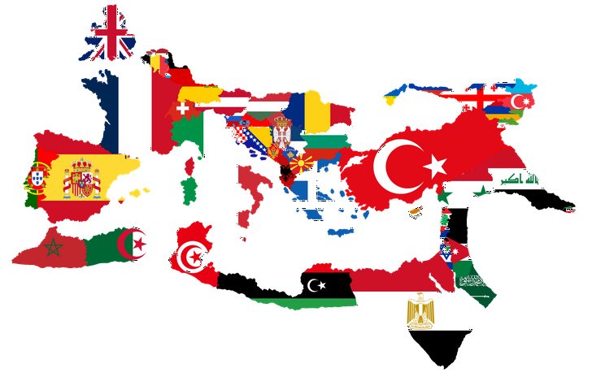
The List
Albania, Austria, Algeria, Belgium, Bosnia, Bulgaria, Croatia, Egypt, England, France, Gibraltar, Greece, Hungary, Iraq, Israel, Italy, Jordan, Lebanon, Libya, Luxembourg, Moldova, Morocco, Portugal, Romania, Slovenia, Spain, Switzerland, Syria, Tunisia, Turkey, Ukraine, Wales.
These are the nations that were conquered by Rome.

Slide 14
Foreshadowing of things to come?
There are no Verses in the Bible.
Dan 9:
26“And after the sixty-two weeks
Messiah shall be cut off, but not for Himself ;
And the people of the prince who is to come
Shall destroy the city and the sanctuary.
The end of it shall be with a flood,
And till the end of the war desolations are determined.
27Then he shall confirm a covenant with many for one week ;
But in the middle of the week
He shall bring an end to sacrifice and offering.
And on the wing of abominations shall be one who makes desolate,
Even until the consummation, which is determined,
Is poured out on the desolate.”

Slide 15
Points to Consider
Antiochus Epiphanes
This Greek King entered the Temple and sacrificed a Pig on the alter. He offered it to a statue of Zeus. This was the Abomination in the sanctuary that brought an end to the sacrifices.
He made the people eat Pork or face death.
He did not destroy the temple but he made it unclean for around 6 1/2 years.
He made no covenant with Israel.
He was vicious and cruel and would persecute the Jews for sport.
He ruled the Northern Kingdom of Greece after Alexander the Great and made war with the southern Kingdom of Greece.
The route to go to battle was straight thru Israel and he would use them as practice.
Daniel identifies his actions as foreshadowing of the Antichrist to come in the end times.

Slide 16
So Who are “The People”?
Roman or Greek
From the List of people groups conquered by the Romans in the previous slide we can see modern day enemies of Israel.
We must remember that Rome would conquer a nation and then recruit and hire “Conscripts”. These are conquered people forced to join the army and fight on Romes behalf.
These “people” more than likely, fought against Israel in AD70.
So the people of the prince who is to come could possibly evolve from any of the listed people groups. But let’s look at it logically against current world events.

Slide 17
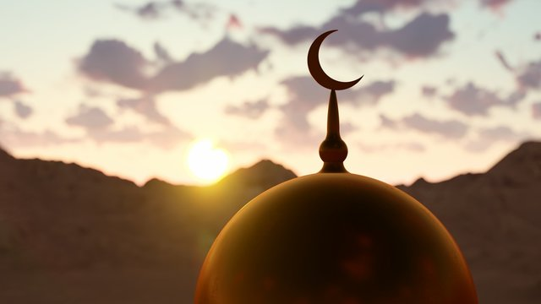
These are current Enemies of Israel
The Short List
Egypt (Peace Treaty)
Iraq (Diplomatic Relations)
Jordan (Peace Treaty)
Lebanon
Lybia
Syria
Turkey
What is their common Religion? Islam
Consider the Red Heifers & The Third Temple.
Does there need to be a 3rd Temple for prophesy to be fulfilled?

Slide 18
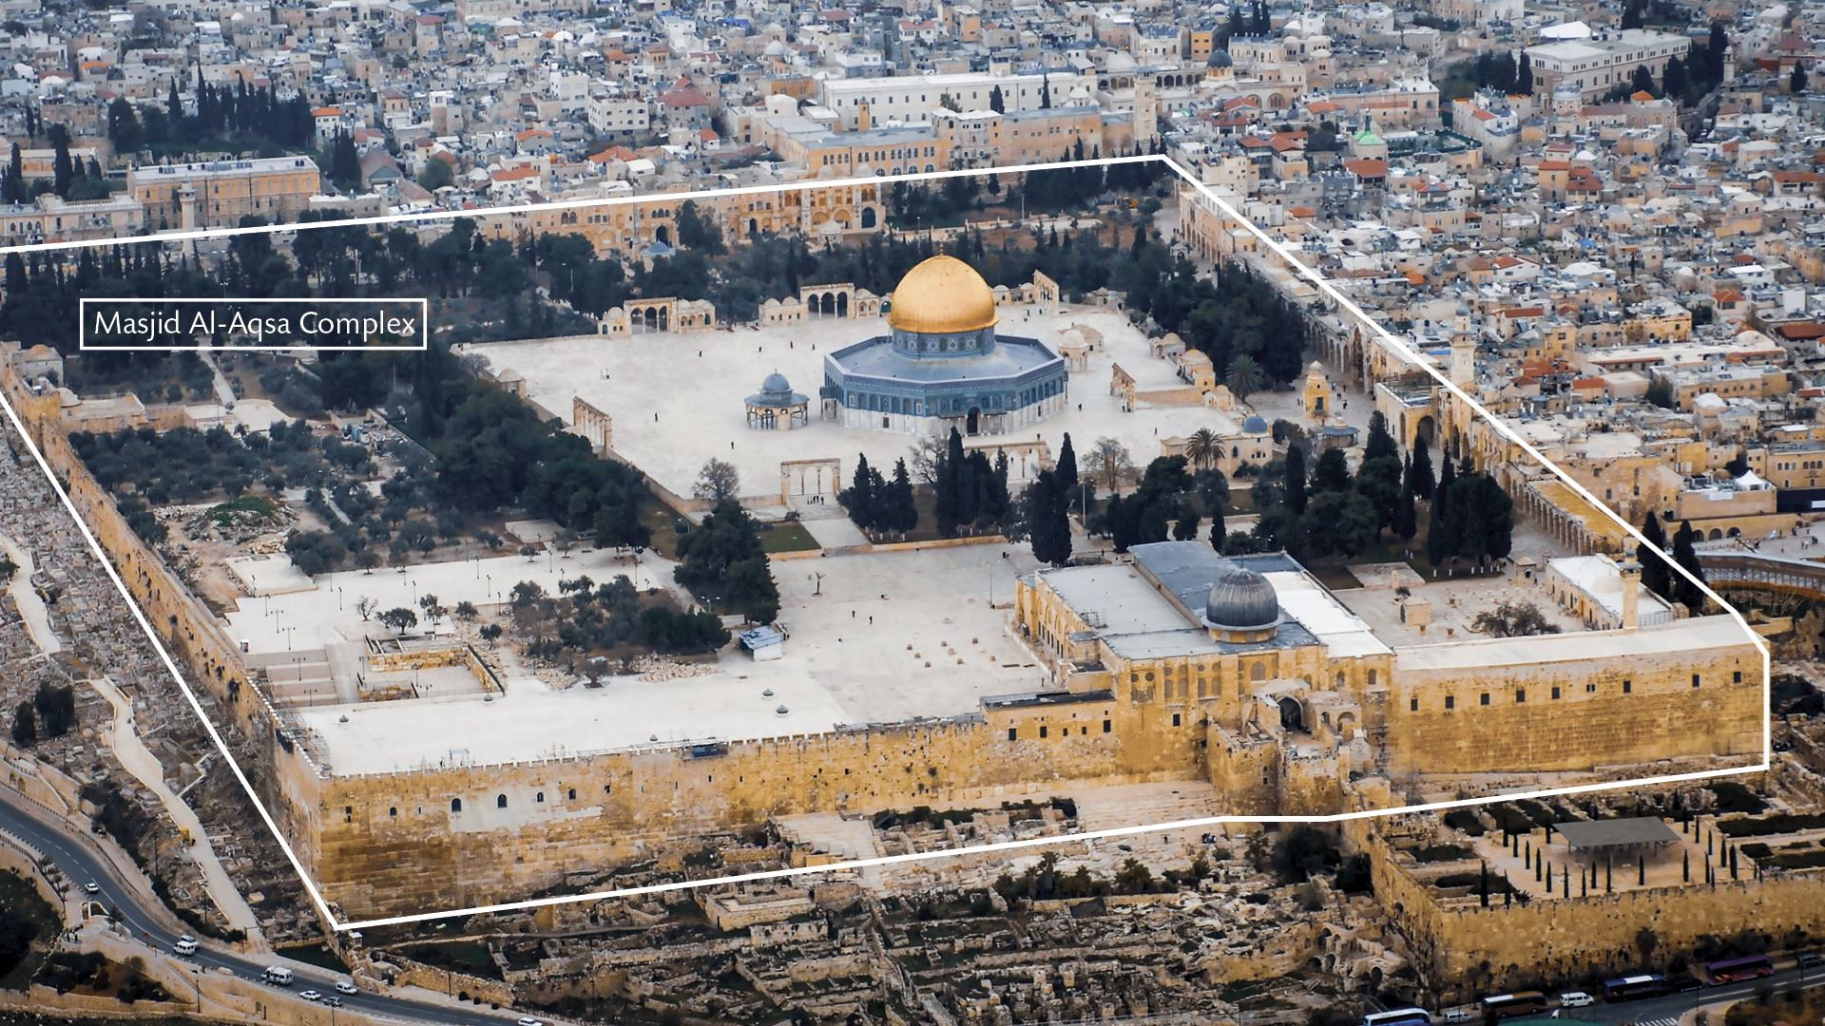
The Dome of the Rock.
This is an Islamic Temple.
It is a “Holy Place” in Islam.
The Red Heifers are intended to cleans the Jewish Priests so they can begin the sacrifices again.
Why Did Oct 7th happen? To prevent the sacrifice. Motive.
Do we need a third Jewish Temple? Traditional teaching says yes, but perhaps this is wrong?
Per Ezekial there will be another Temple.

Slide 19
Could the Dome of the Rock be the “Holy Place”?
It’s subtle.
2Th 2:3 Let no one deceive you by any means; for that Day will not come unless the falling away comes first, and the man of sin is revealed, the son of perdition,
2Th 2:4 who opposes and exalts himself above all that is called God or that is worshiped, so that he sits as God in the temple of God, showing himself that he is God.
- “Sits as God” is key to understanding exactly what the Antichrist is going to do. God sat on the Ark, the Mercy seat, in the Temple, The Holy of Holies.
-Temple- Strongs G3485 -used of the temple at Jerusalem, but only of the sacred edifice (or sanctuary) itself, consisting of the Holy place and the Holy of Holies (in classical Greek it is used of the sanctuary or cell of the temple, where the image of the god was placed which is distinguished from the whole enclosure)

Slide 20
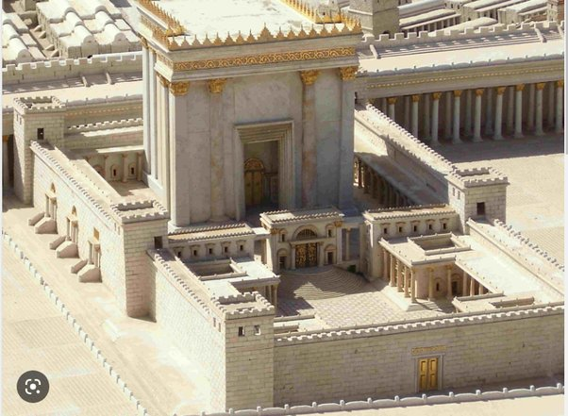
We See This?
The Temple

Slide 21
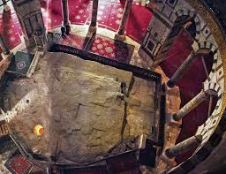
But It actually means this.
The Foundation Stone

Slide 22
The Holy of Holies
Size Matters
The Holy of Holies was a room within the temple, separated from the rest of the building by a veil and curtains. The Holy of Holies was a cube measuring 20 cubits by 20 cubits by 20 cubits,(30x30x30) located at the westernmost end of the temple. The temple was a place of worship used for spiritual activities like prayer and sacrifice. The Holy of Holies was thought to be the dwelling place of God on Earth, and was used to store the Ark of the Covenant, which contained the stone tablets inscribed by God.
Could a Muslim, today, enter the Holy of Holies and sit and proclaim himself as god?

Slide 23
Does Satan Know?
Where is the True location of the Holy of Holies?
The exact location of the Holy of Holies on Temple Mount in Jerusalem is disputed:
Foundation Stone Some classical Jewish sources say the Holy of Holies was located on the Foundation Stone, which is under the Dome of the Rock. The traditional view is that the Dome of the Rock is on the site of the Temple.
Dome of the Spirits According to Kaufman, the Holy of Holies was located at the Dome of the Spirits, which is northwest of the Dome of the Rock. The Foundation Stone would be the rock under the Dome of the Spirits.
Well of Souls Christian Crusaders believed the Holy of Holies was in the Well of Souls, a small cave under the Foundation Stone in the Dome of the Rock.
El Kas foundation Some say that if Baalbek architecture is the correct model, the Holy of Holies is located under the El Kas foundation. I explain this to you so you will know what to be looking for. Imagine the confusion if this happens and there is no 3rd Temple in Jerusalem.
https://madainproject.com/interactive_map_of_the_temple_mount/

Slide 24
Quick Summary
Luke 21 Prophesy
Obvious Diversity concerning the peoples of a Renewed Roman Empire. Iron and Clay.
Daniel 9:26-27 - We now understand it is skipping through time.
In order to reveal the AC, a 3rd temple may not be necessary.
Let’s tie this all together.

Slide 25
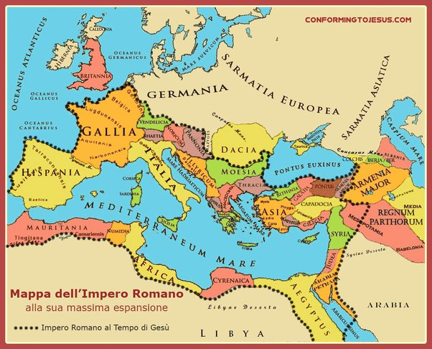
The Roman Empire
When we look at the areas that Rome conquered and knowing that Daniel was explaining end time events we must assign his visions to the current climate of our world today.
The areas conquered are now mostly Islamic, this could include Spain, Britain France and the UK as well in current times.
Let’s make some comparisons to strengthen this argument.

Slide 26
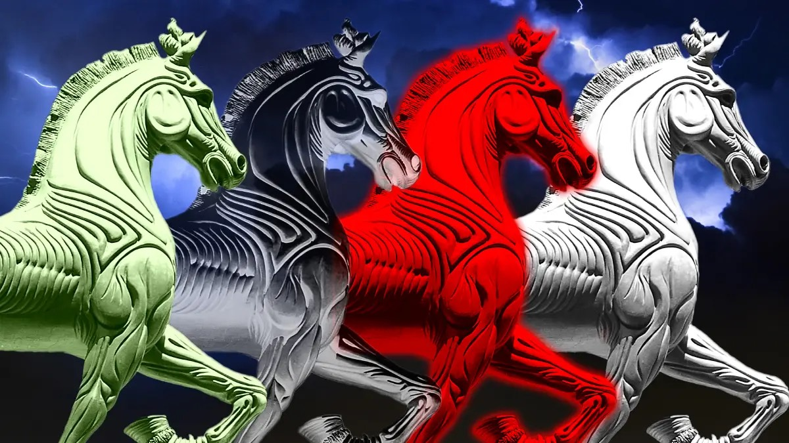
The 4 Horseman
Are The Seals Open?
White - Conquest
Red- War
Black - Famine
Green - Death
& Hell follows with it.

Slide 27
IRAN
IRAQ
KUWAIT
TURKEY
SYRIA

Slide 28
Rapture
Jesus Coming Soon
Luk 21:23 “But woe to those who are pregnant and to those who are nursing babies in those days! For there will be great distress in the land and wrath upon this people.
Luk 21:24 “And they will fall by the edge of the sword, and be led away captive into all nations. And Jerusalem will be trampled by Gentiles until the times of the Gentiles are fulfilled.
The Coming of the Son of Man
Luk 21:25¶“And there will be signs in the sun, in the moon, and in the stars; and on the earth distress of nations, with perplexity, the sea and the waves roaring; I Believe we are right HERE.
Luk 21:26 “men’s hearts failing them from fear and the expectation of those things which are coming on the earth, for the powers of the heavens will be shaken.
Luk 21:27 “Then they will see the Son of Man coming in a cloud with power and great glory.
Luk 21:28 “Now when these things begin to happen, look up and lift up your heads, because your redemption draws near.”
We, his church, are those that he will redeem. Purchase, get something back.

Slide 29
We will Rule & Reign with him.
1000 Years
Dan 7:25 He shall speak pompous words against the Most High, Shall persecute the saints of the Most High, And shall intend to change times and law. Then the saints shall be given into his hand For a time and times and half a time.
Dan 7:26 ‘But the court shall be seated, And they shall take away his dominion, To consume and destroy it forever.
Dan 7:27 Then the kingdom and dominion, And the greatness of the kingdoms under the whole heaven, Shall be given to the people, the saints of the Most High. His kingdom is an everlasting kingdom, And all dominions shall serve and obey Him.’
Rev 20:4 ¶And I saw thrones, and they sat on them, and judgment was committed to them. Then I saw the souls of those who had been beheaded for their witness to Jesus and for the word of God, who had not worshiped the beast or his image, and had not received his mark on their foreheads or on their hands. And they lived and reigned with Christ for a thousand years.
G2362- PARTNER IN DIVINE ADMINISTRATION, ELDER (MAYBE THE 24) OR JUDGE
REMEMBER LOTS WIFE. “NO TURNING BACK.” You cannot love your life, more than you love Christ.
Jesus paid the price for you now, in the tribulation you will pay your own way.

Slide 30
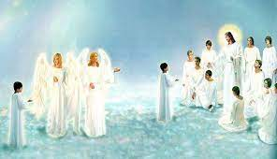
There will still be work to Do.
Ruling & Reigning
According to the bible, the saints, will still be ministering to those that survive the tribulation. Priests.
We will be teaching their children of the things that happened on the earth before the millennial reign.
We will be enforcers of the Ordinance of God.
And we will see the Final White Throne Judgement. 2nd death.

Slide 31
Summary
We see how the Roman empire acquired many peoples and these areas are now under strong Islamic influence.
We see how the colors of the four horses could have been code pointing us in the direction of an islamic caliphate.
I gave a personal marker of where I believe we are at using Luke 21:25 …the sea and the waves roaring.
We learned that it will be Gods divine administration, (Possibly Angelic Elders) that will destroy the kingdom of Satan.
Lastly, we know that there will be work to be done during the millennial reign with Christ.

Slide 32
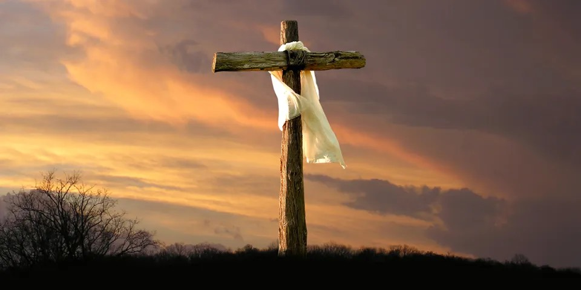
A-B-C
JESUS PAID THE PRICE FOR YOU NOW. IN THE TRIBULATION, YOU WILL PAY THE PRICE.
A-sk Jesus to live in your heart.
B-elieve that he is the Son of God, was born of a virgin, died for your sins and rose again on the third day, defeating death, hell and the grave. And he is Coming Back!
C-onfess with your mouth and call upon his name and you shall be saved.

Slide 33
Reference
Luke 21
Daniel 2
Daniel 7
Daniel 9
2 Thessalonians 2
Revelation 6
Revelation 20

